Slide 1
CSE 3001 Review 2
VIRTUAL CLASSROOM
Presented by:
Wilson Vidyut,
Rishank Pratik,

Slide 2

What is Virtual Classroom?
A virtual classroom is a digital replica of a traditional classroom or training room. The instructors teach, interact, communicate, view and discuss presentations, and the participants learn in real-time, face-to-face but via internet-enabled technology devices
Everything remains the way it is. The only difference is: an online classroom uses technology to support instruction and learning. What are the advantages of virtual classroom? It offers more flexibility over a traditional classroom. You can deliver the instruction to a geographically dispersed audience at one time.
2

Slide 3
Diagrams
Use Case Diagram
Activity Diagram
Work Break Down Structure
Sequence Diagram
Class Diagram
Data Flow Diagram

Slide 4
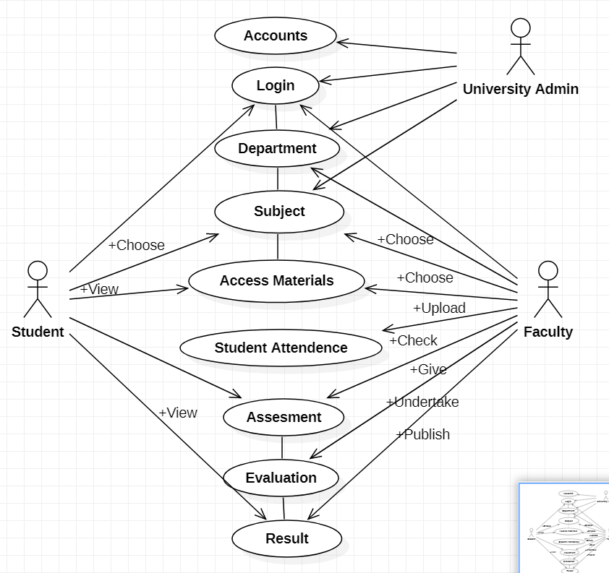
Use Case Diagram
4

Slide 5
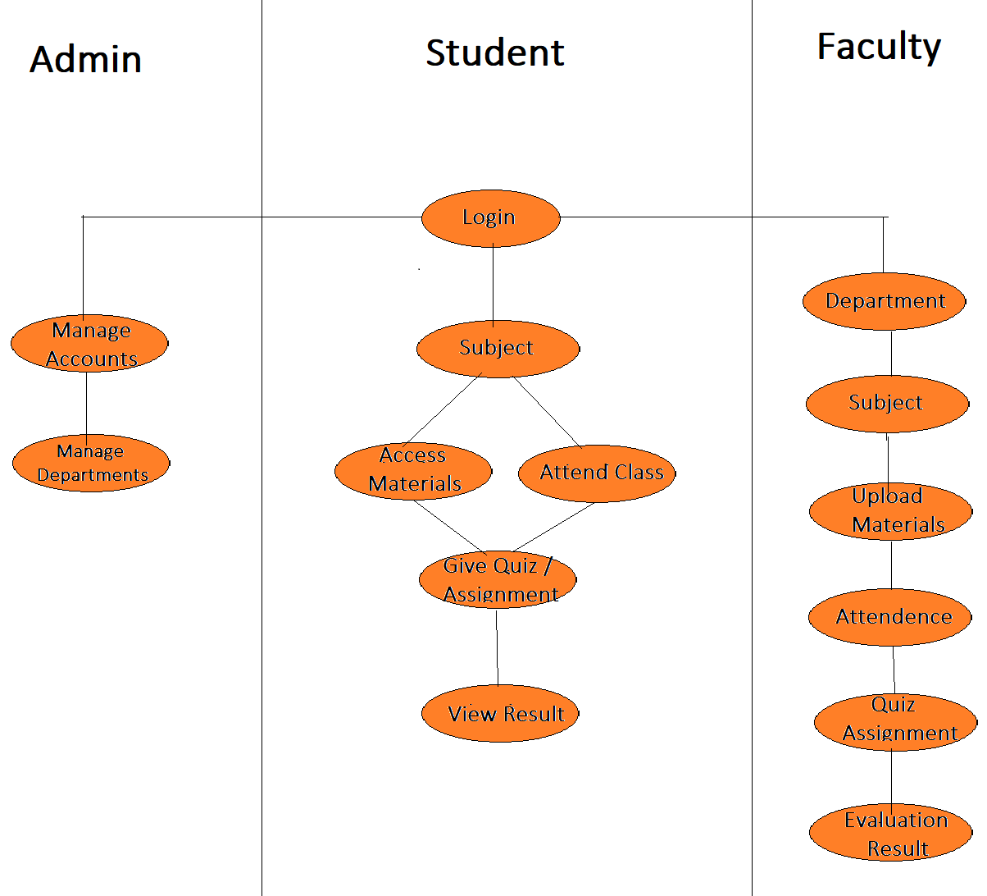
Activity
Diagram
5

Slide 6
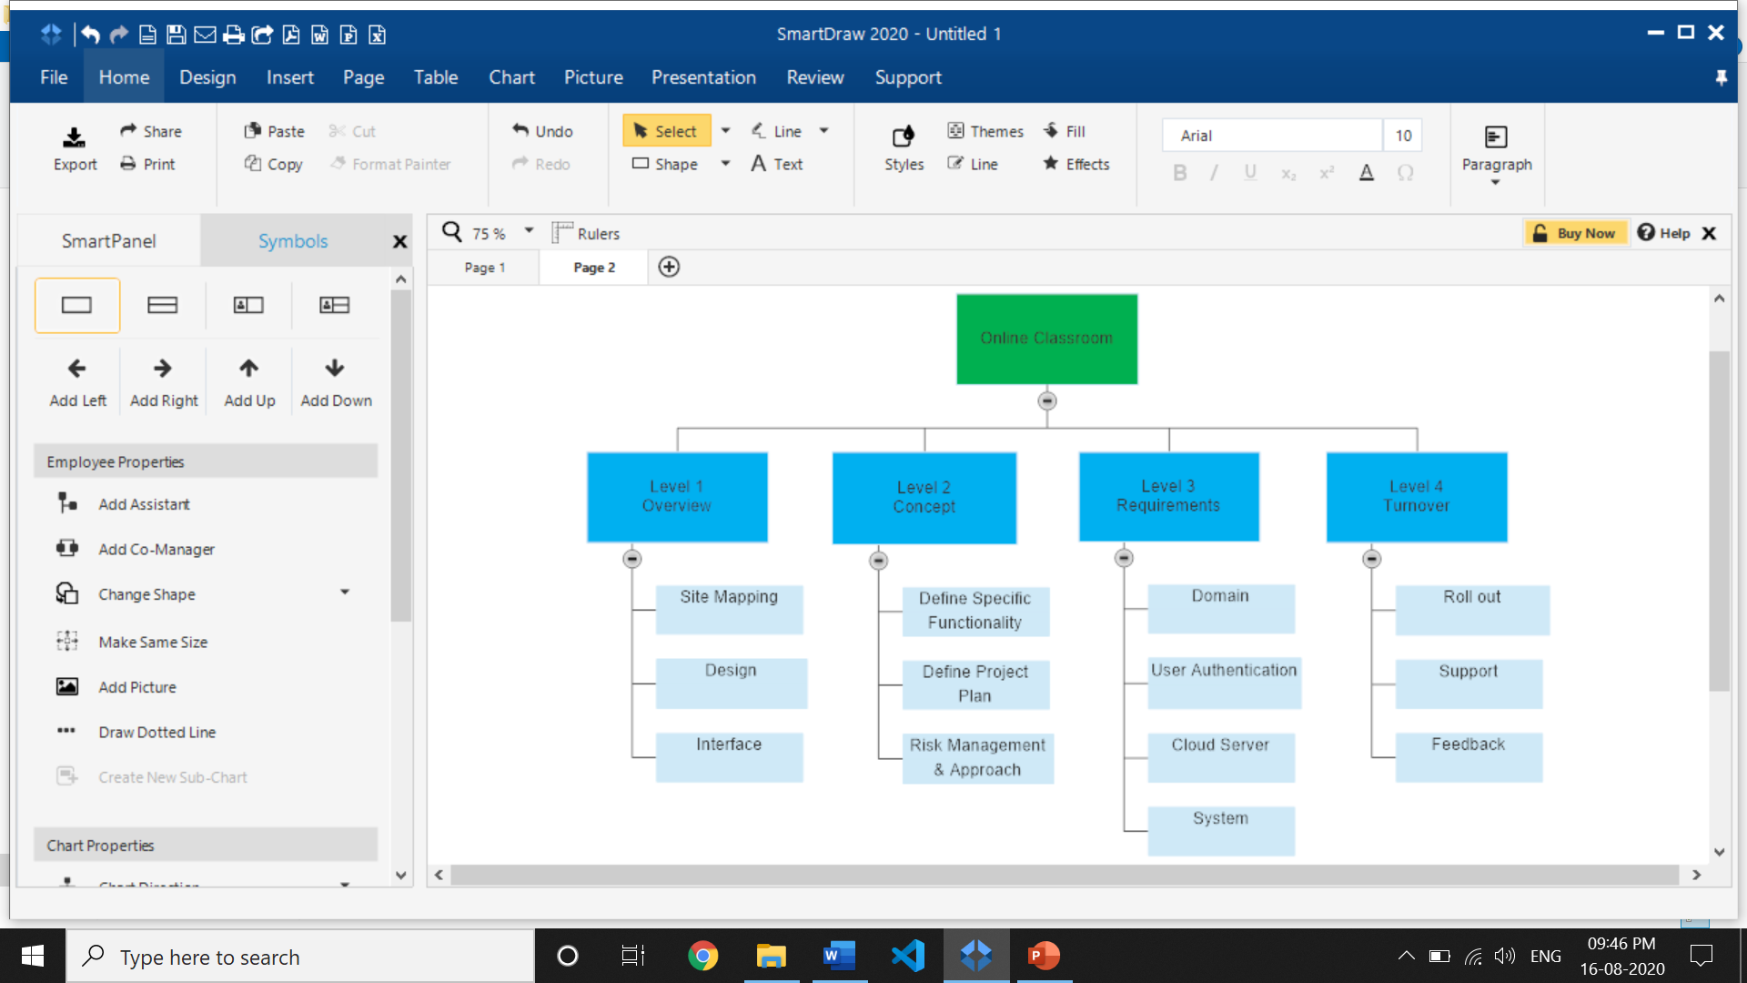
Work Breakdown Structure
(By Phase)
6

Slide 7
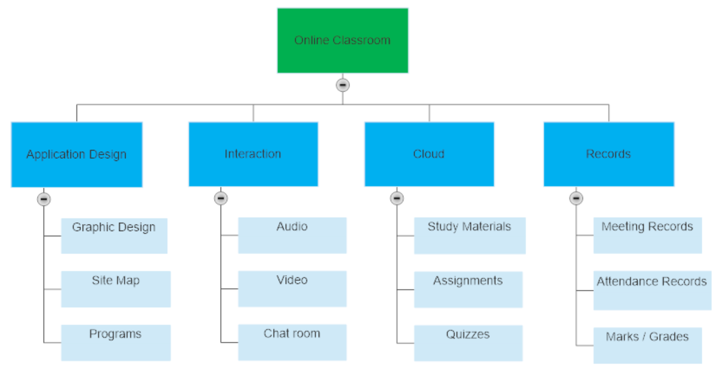
Work Breakdown Structure
(By Product)
7

Slide 8
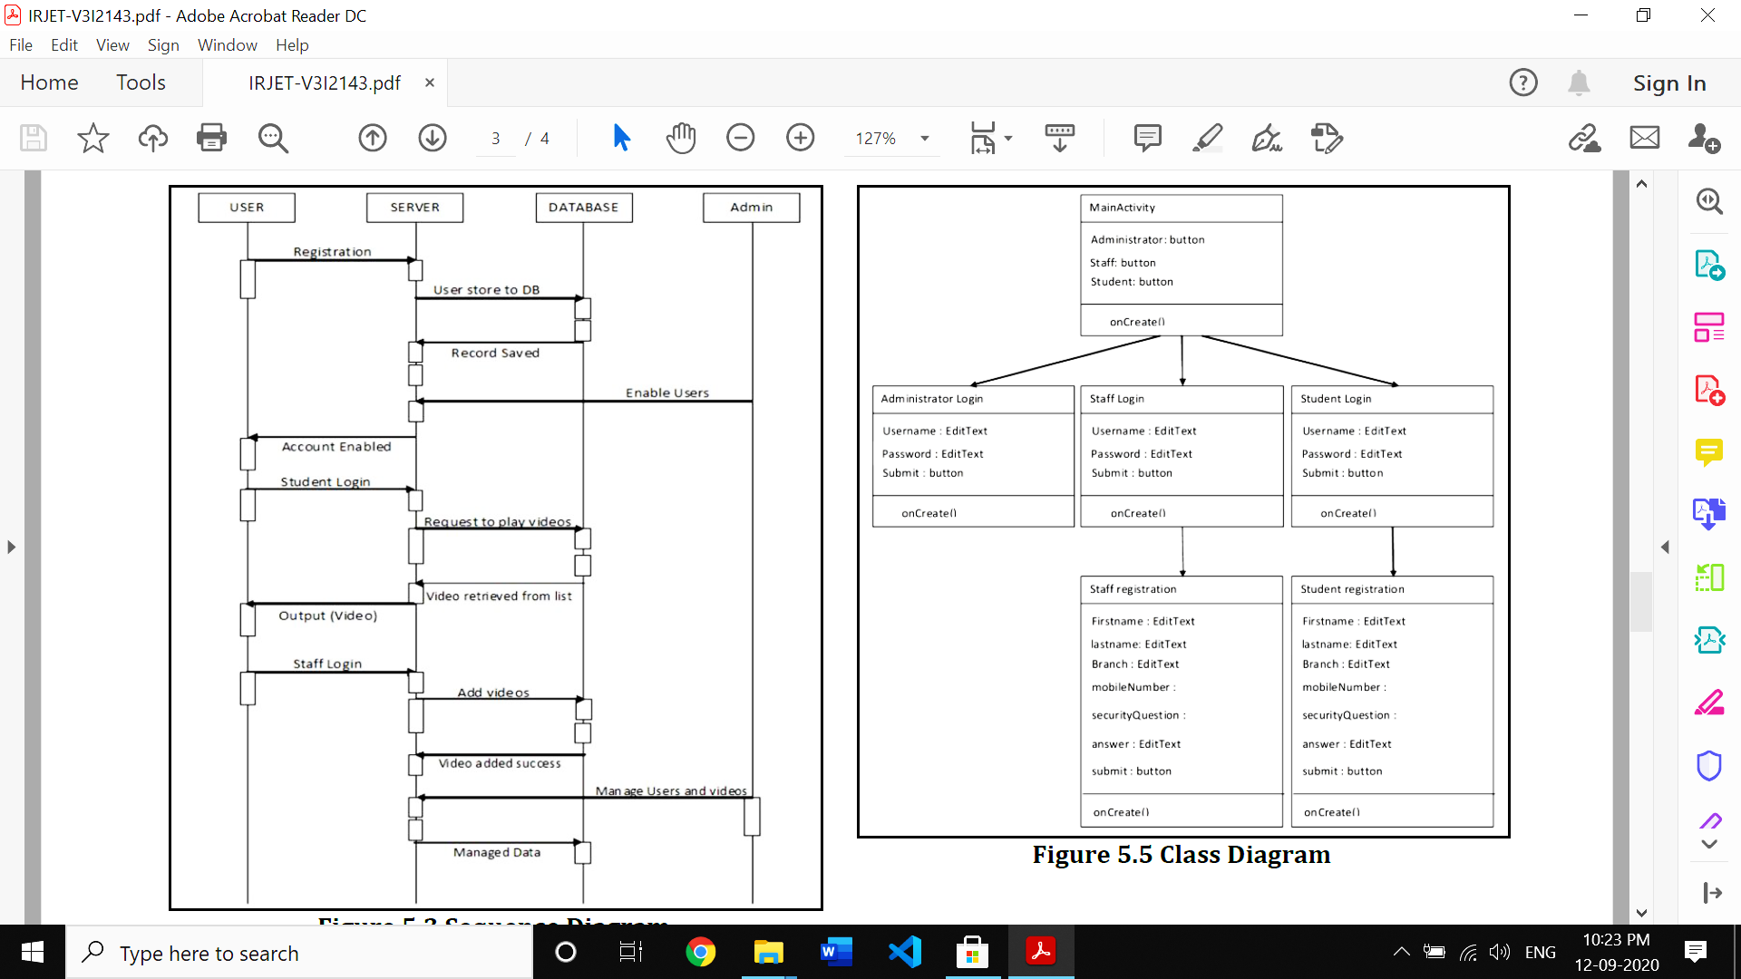
Sequence
Diagram

Slide 9
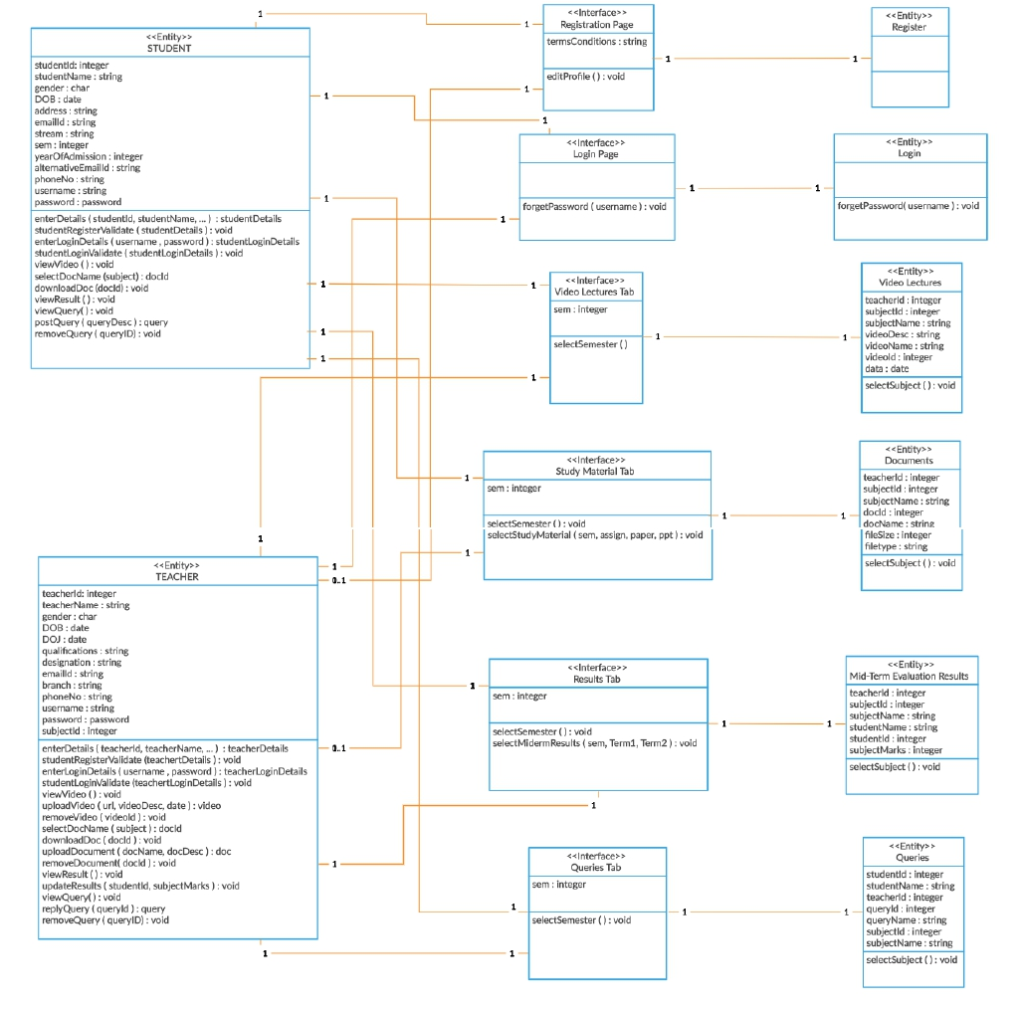
Class
Diagram

Slide 10
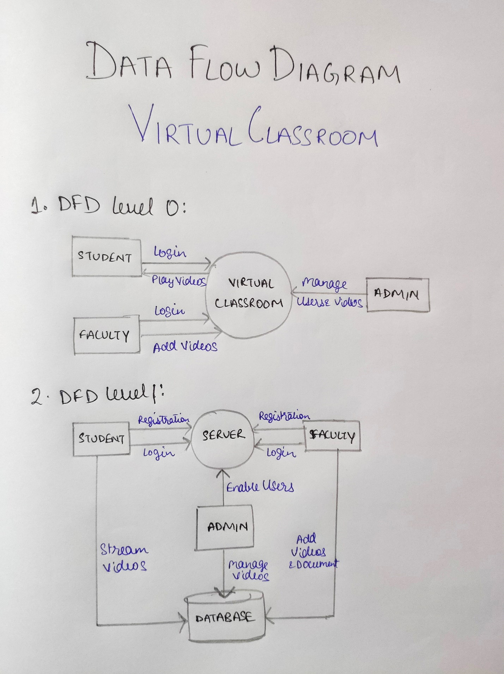
DataFlow
Diagram
Level 1 & 2

Slide 11
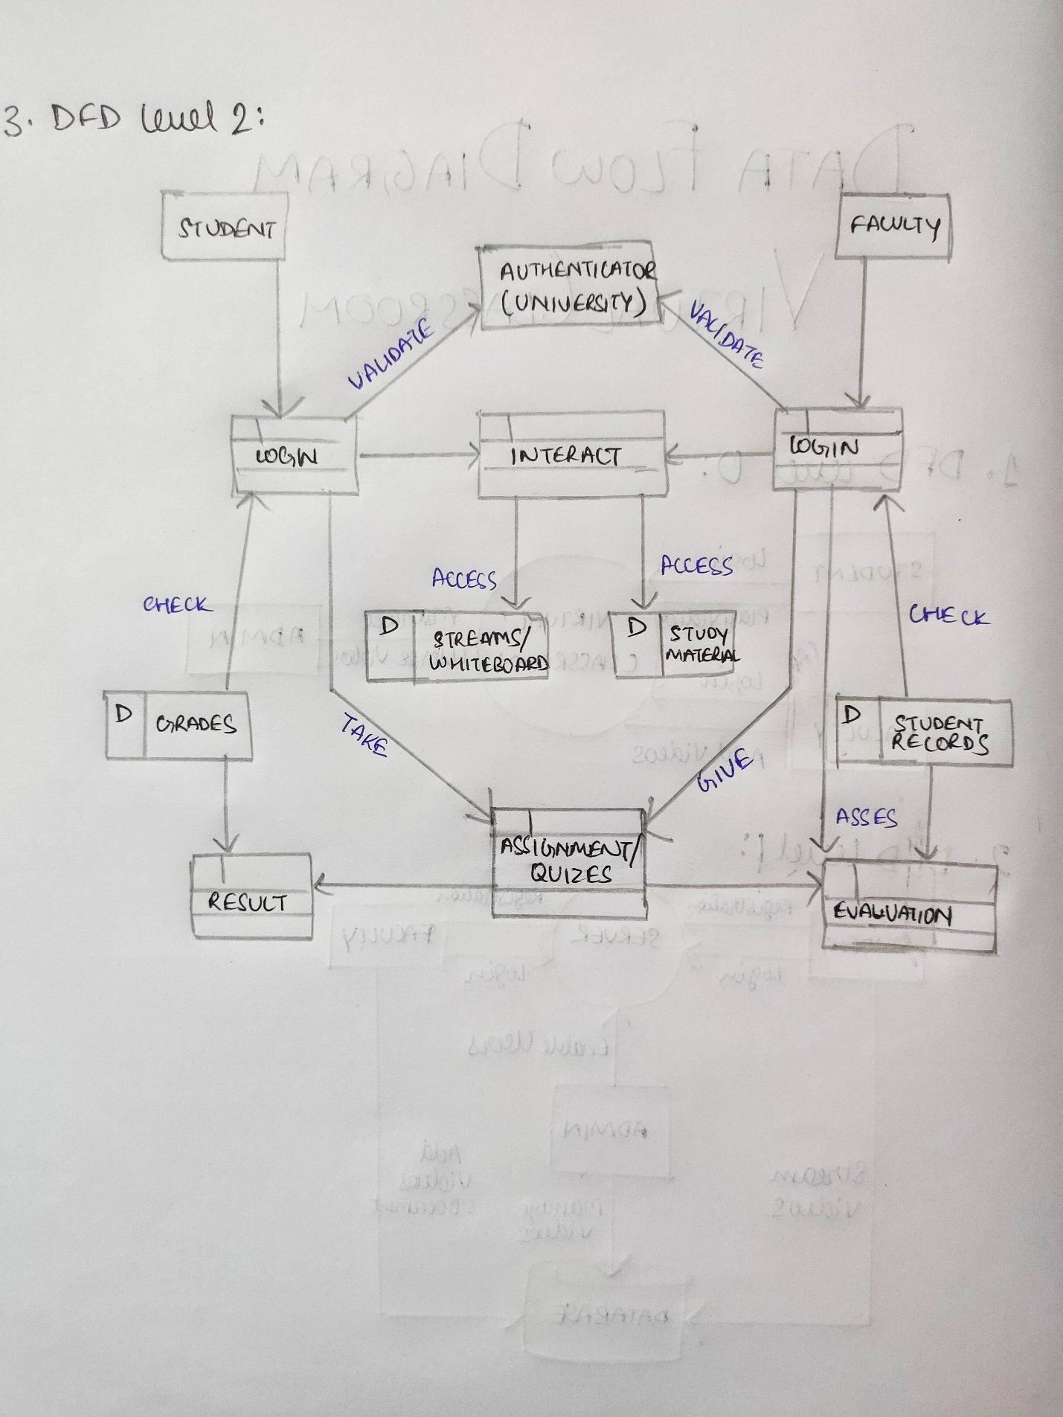
DataFlow
Diagram
Level 3

Slide 12
Modules
12

Slide 13
Accessible
Works in PC as well as in cell phone

Slide 14
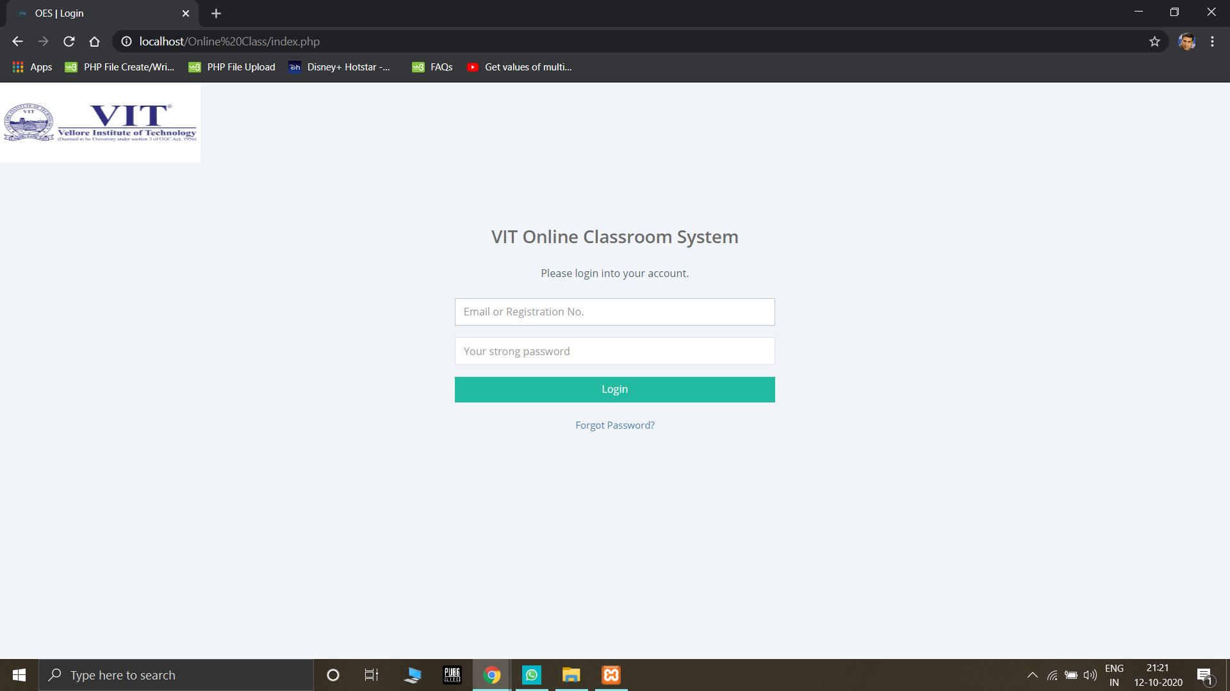
Login Page
(Common for both student & teacher)

Slide 15


Slide 16
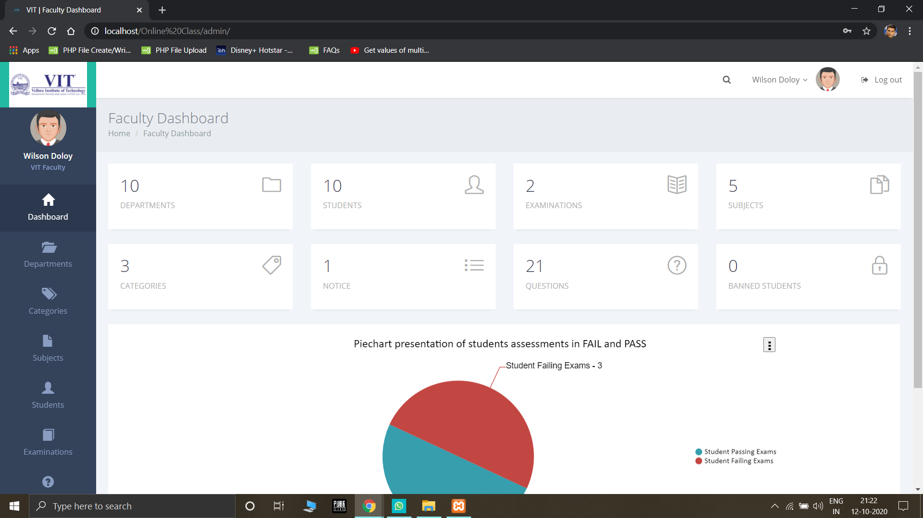
Faculty Dashboard

Slide 17
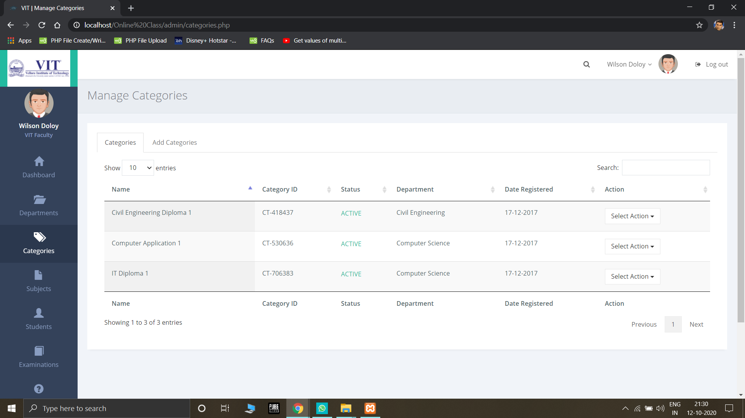
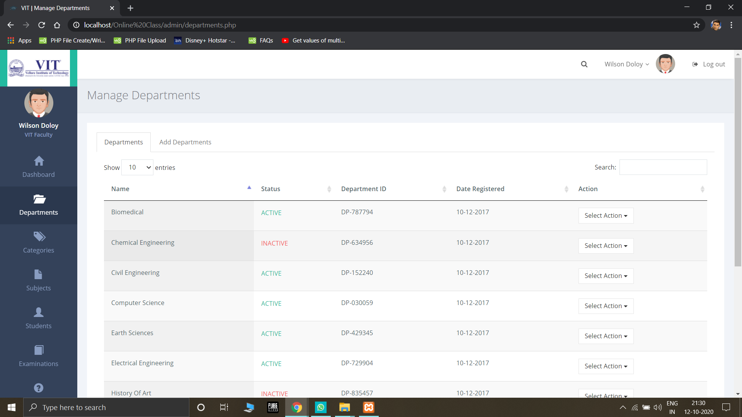
Departments

Slide 18
Categories

Slide 19
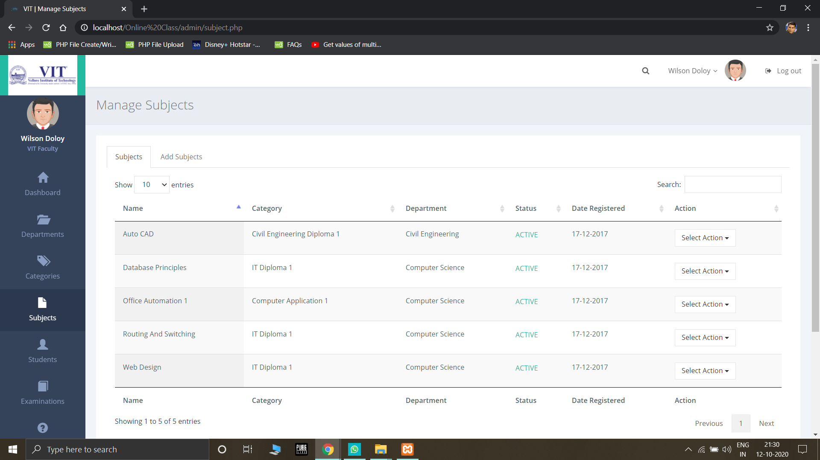
Manage Subjects

Slide 20
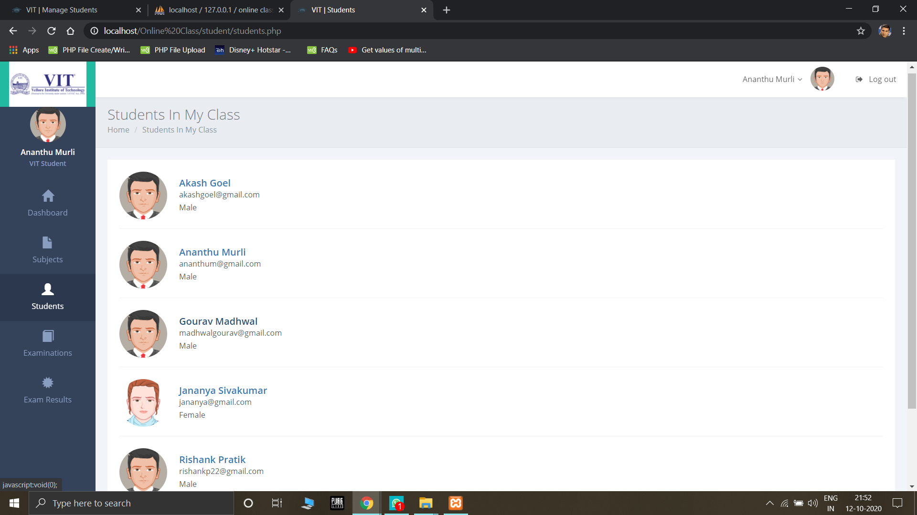
View Students

Slide 21

Student Attendance

Slide 22
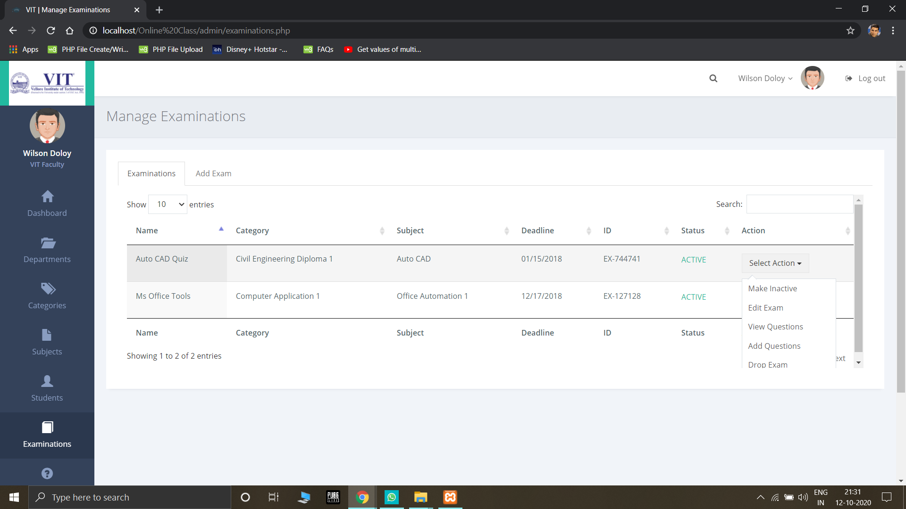
Manage Examinations/Assignments

Slide 23


Slide 24
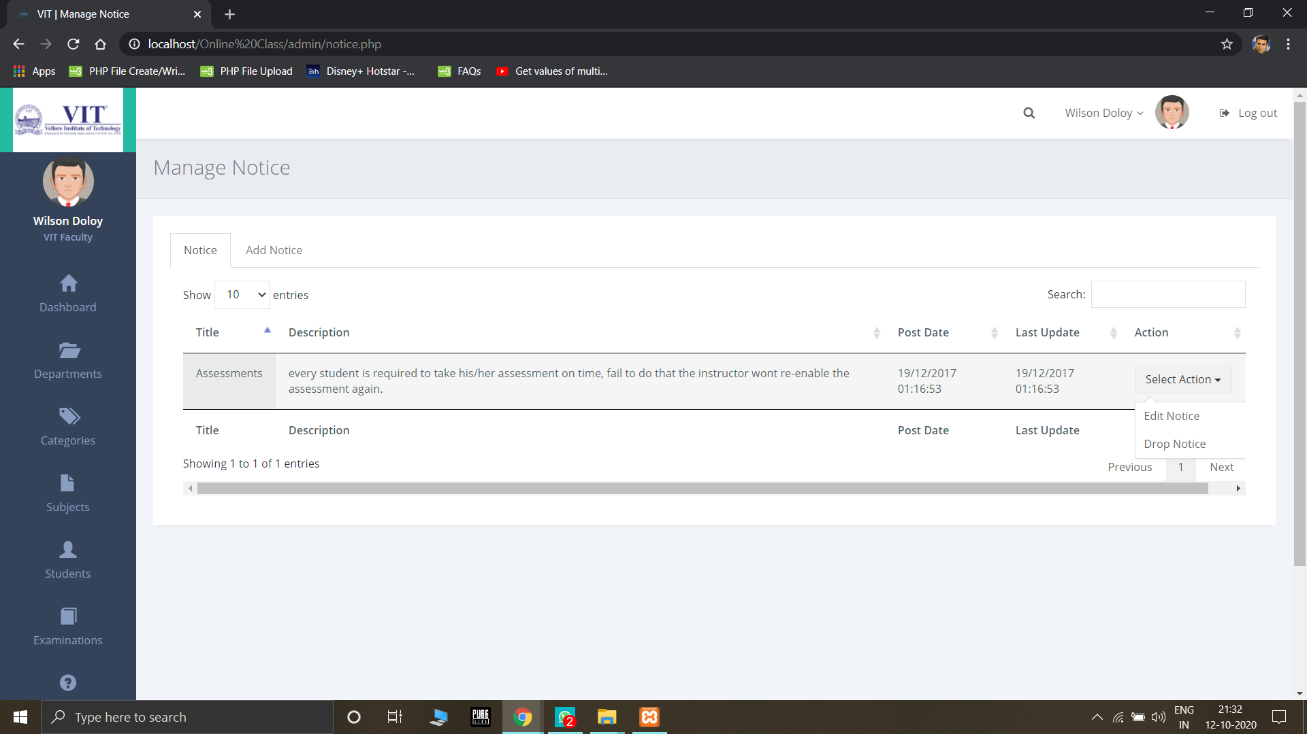
Circulars

Slide 25

Results and Evaluation

Slide 26

Student Dashboard

Slide 27
Difference?
Students don’t have access to:
Departments
Student Attendance
Circular distribution
Evaluation

Slide 28
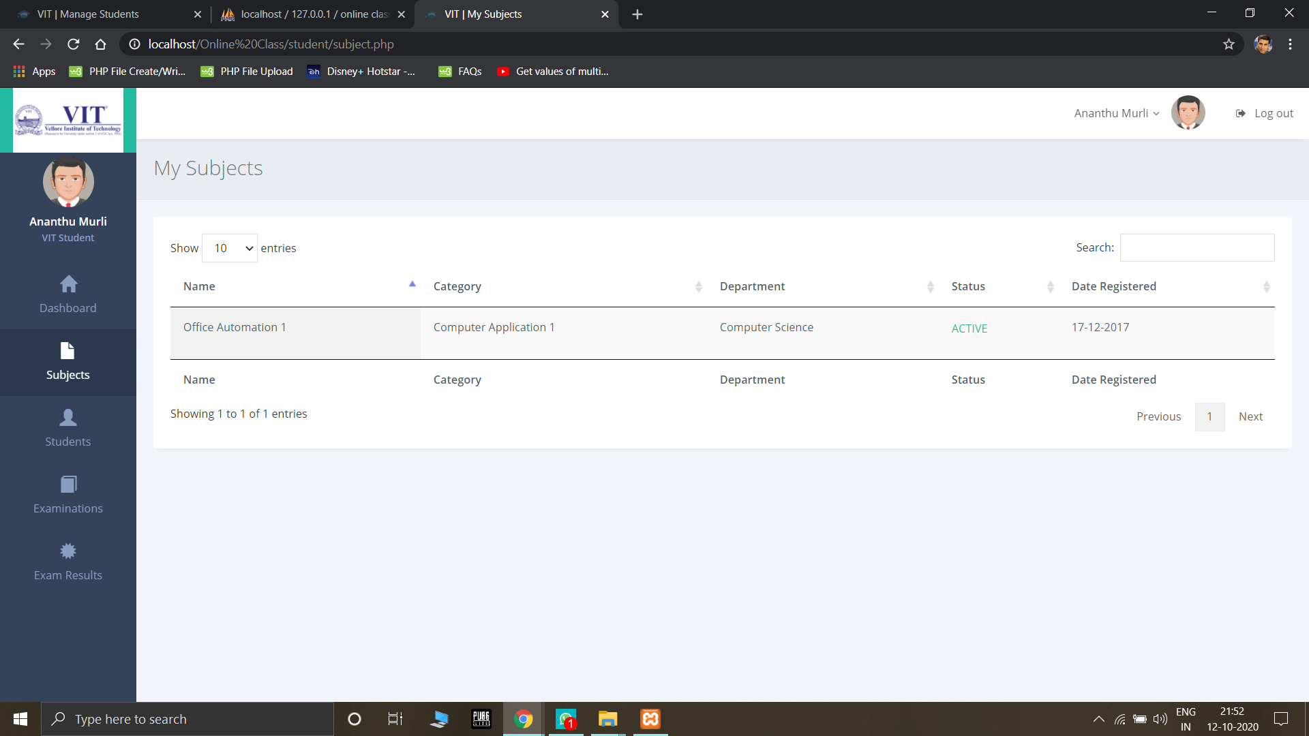
View Subjects

Slide 29
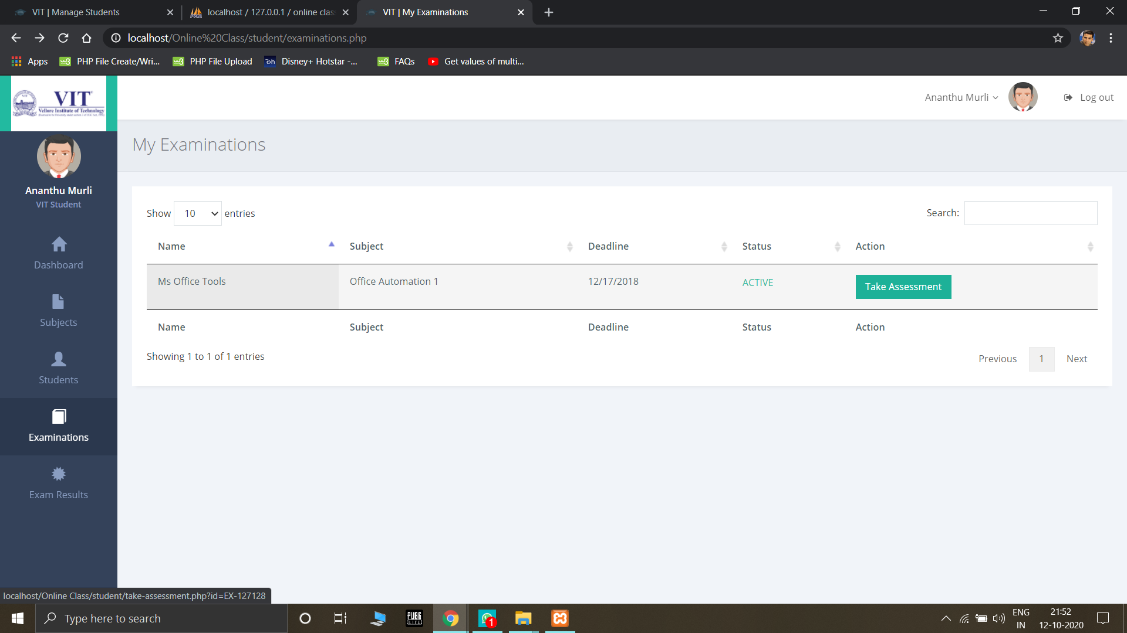
Examination

Slide 30
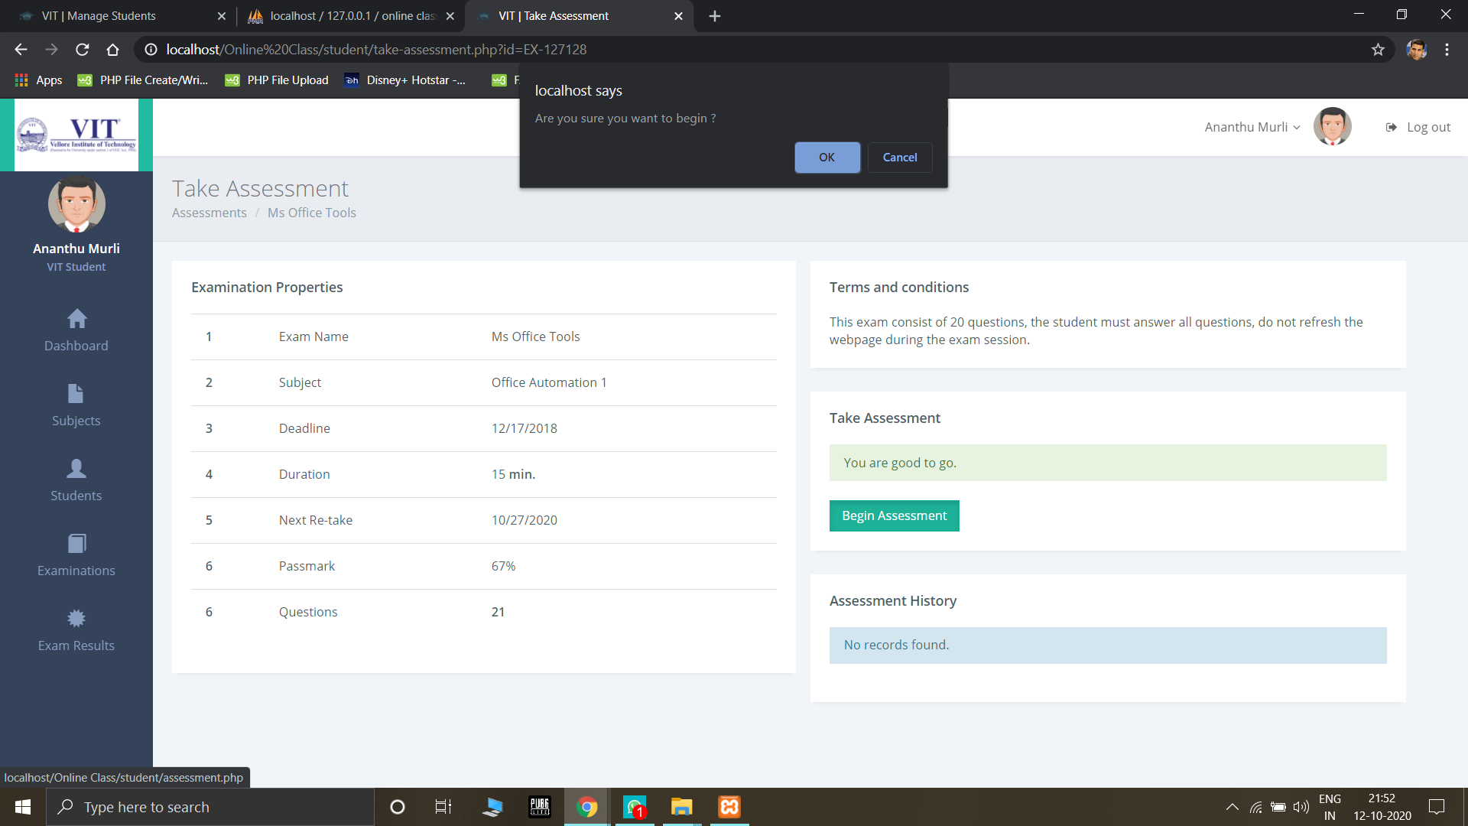
Begin Assessment

Slide 31
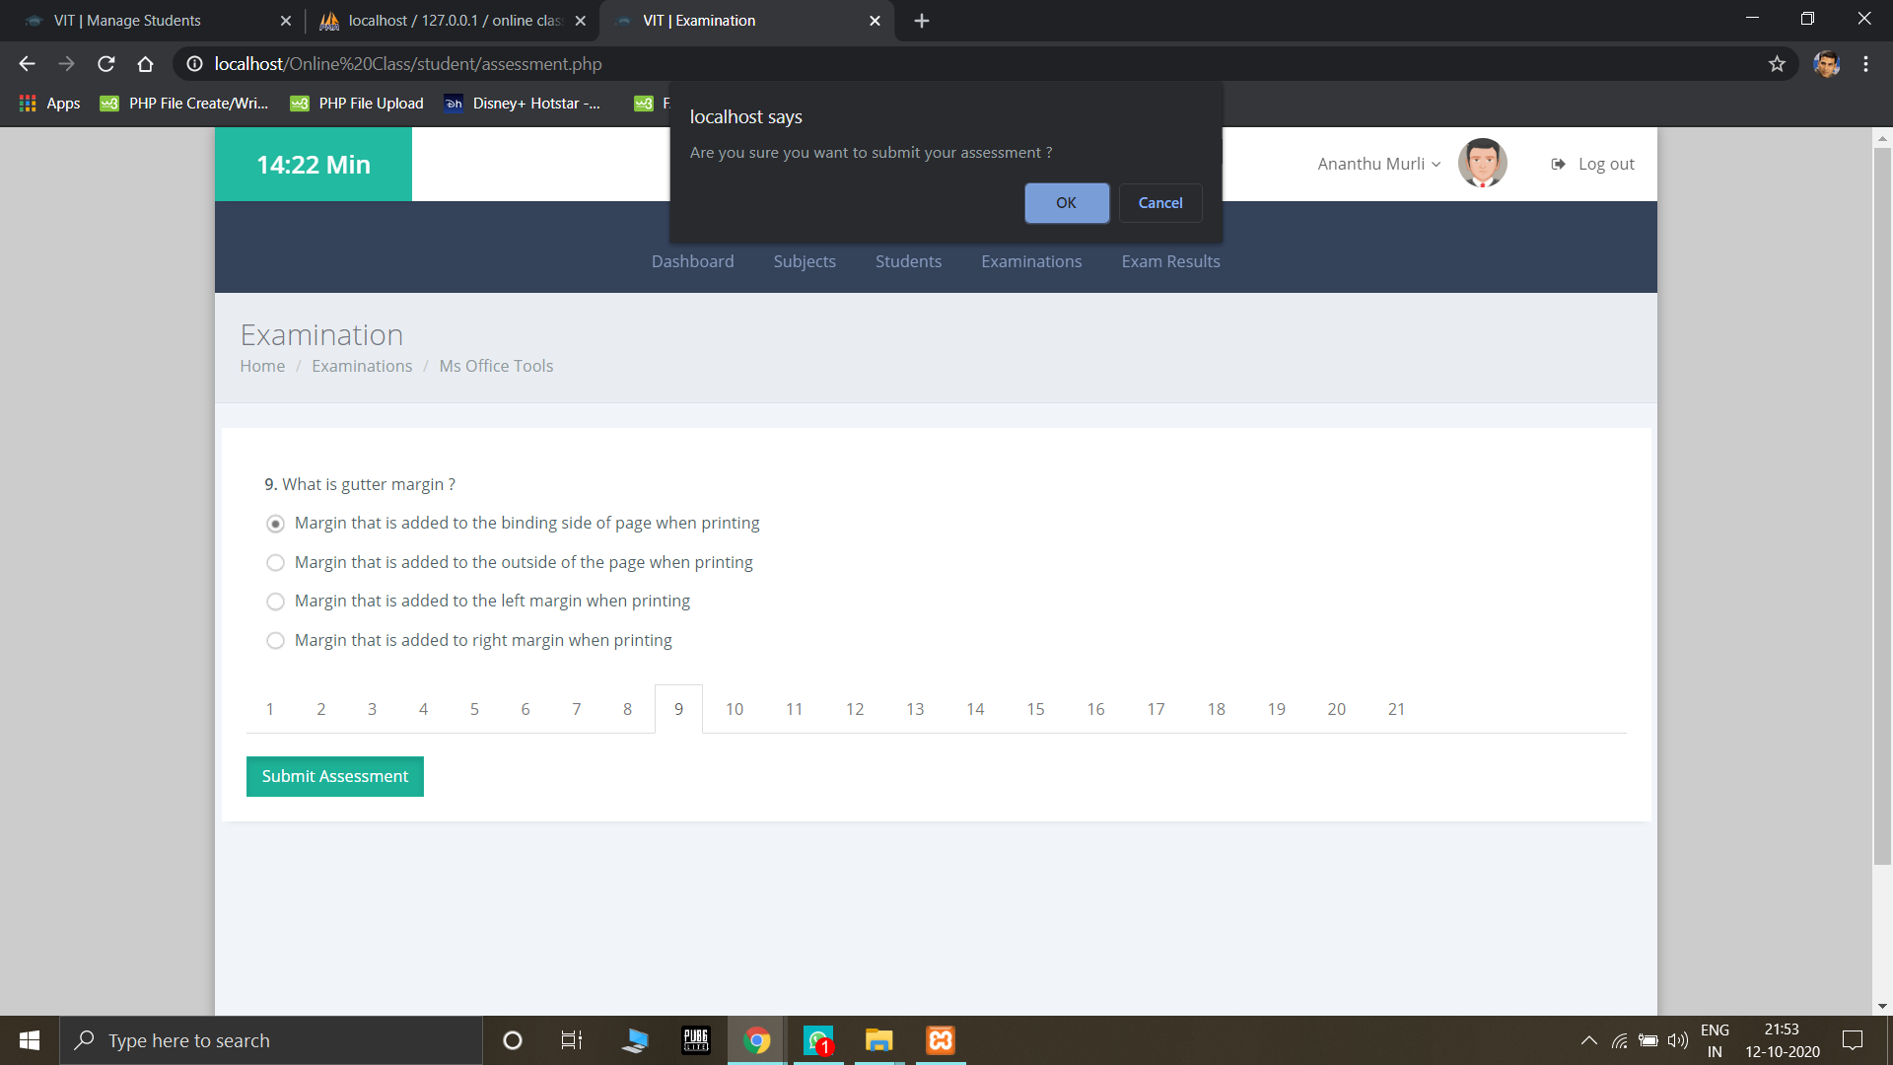
Examination User Interface

Slide 32
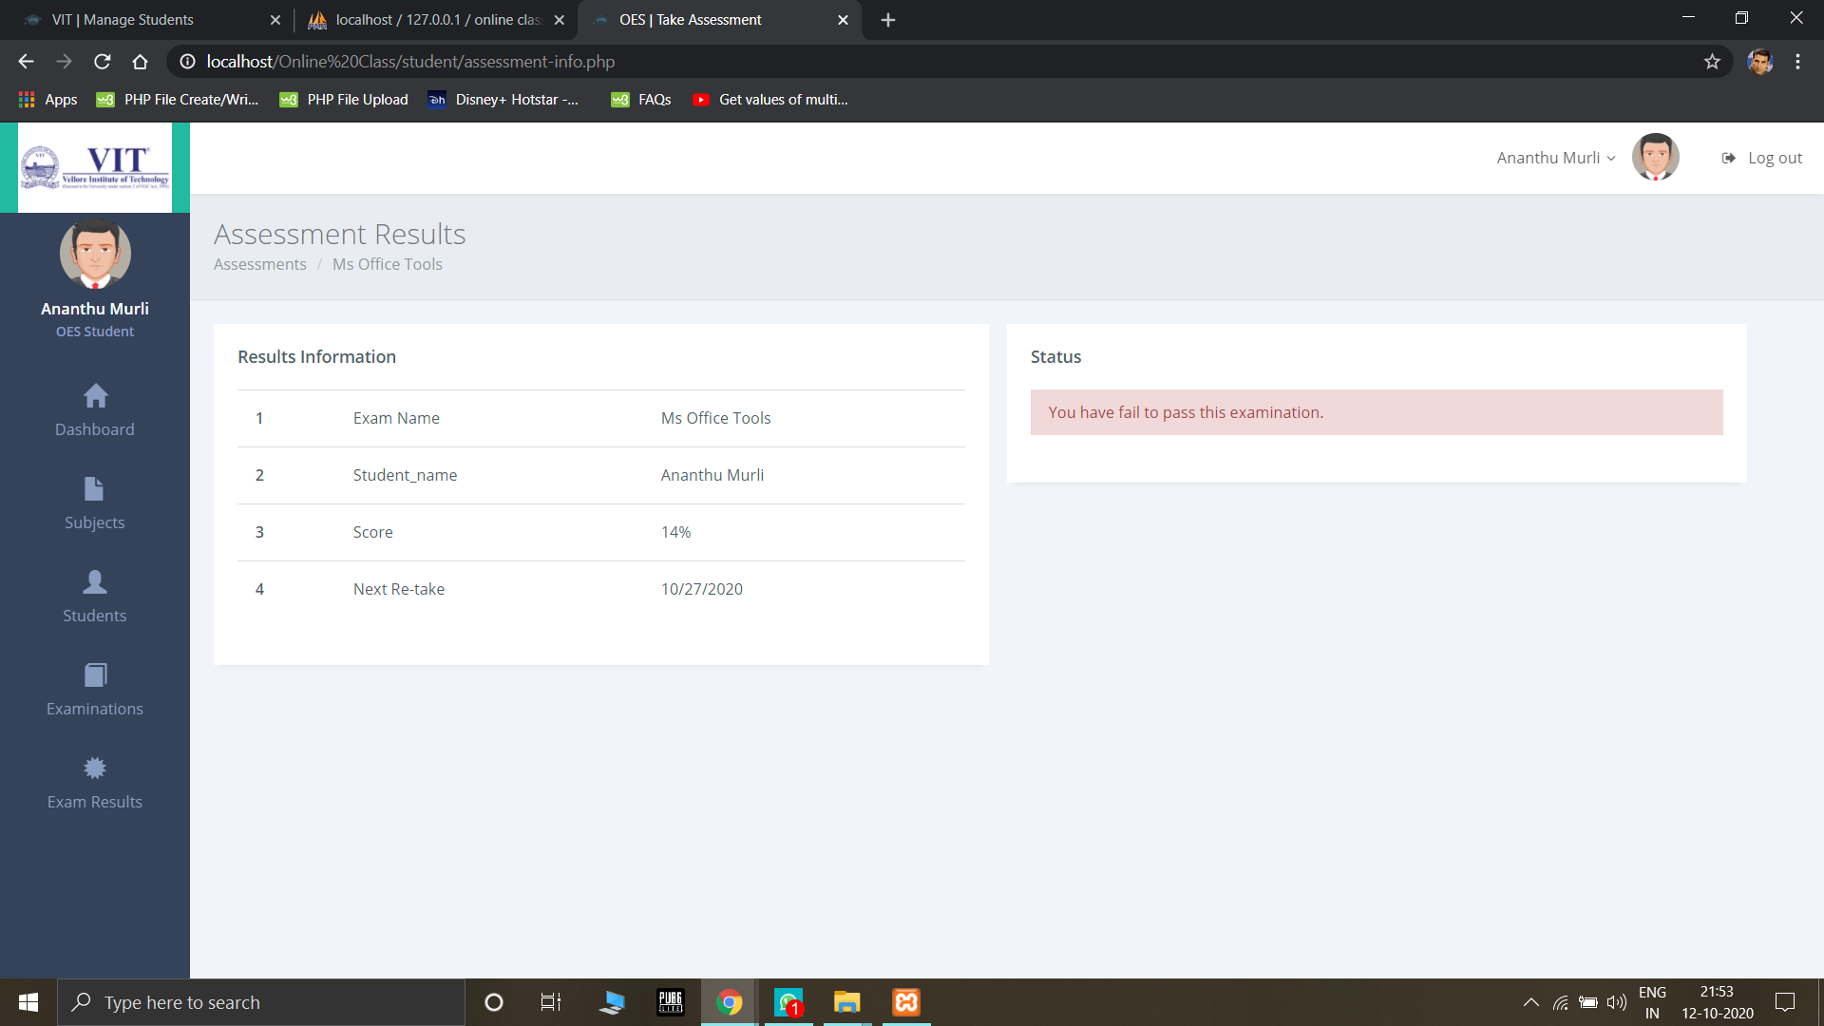
Results

Slide 33
THANKS!
33

